Slide 1
Building a Data Mesh Architecture in Azure
Data Mesh vs Azure (Theory vs Practice)

Slide 2
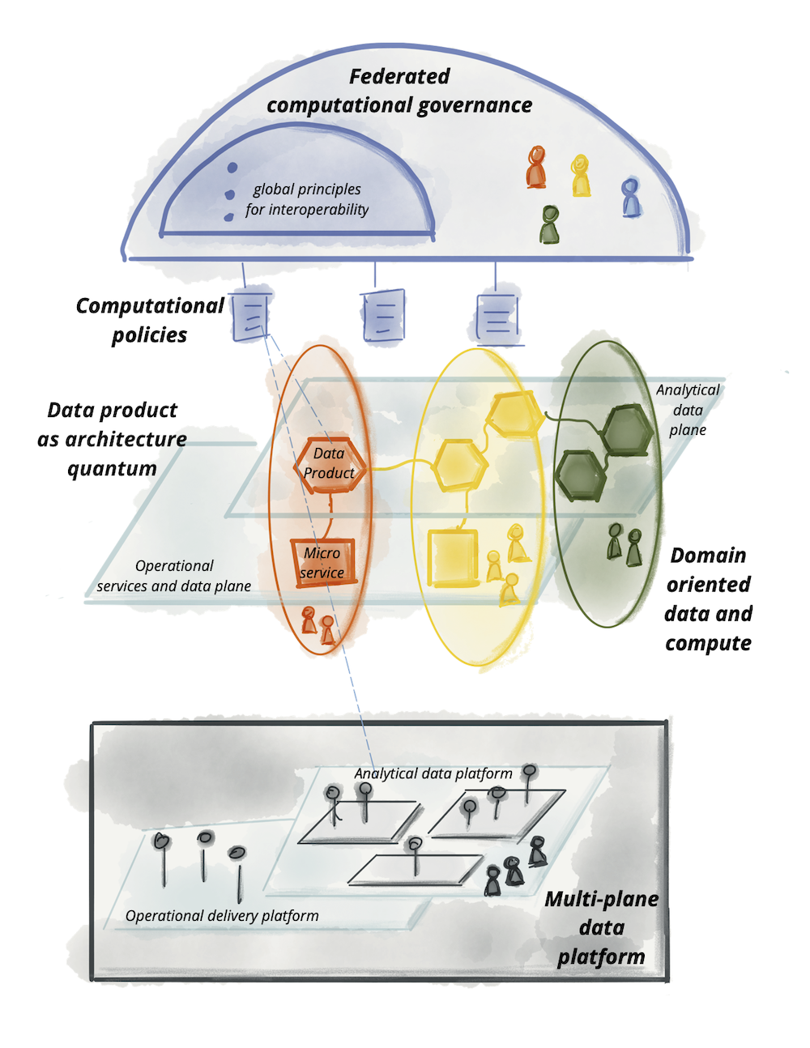
Data Mesh vs Azure – Part 1
Theory vs Practice
Image Source: https://martinfowler.com/articles/data-mesh-principles.html

Slide 3
Data Mesh vs Azure – Part 2
Theory vs Practice

Slide 4
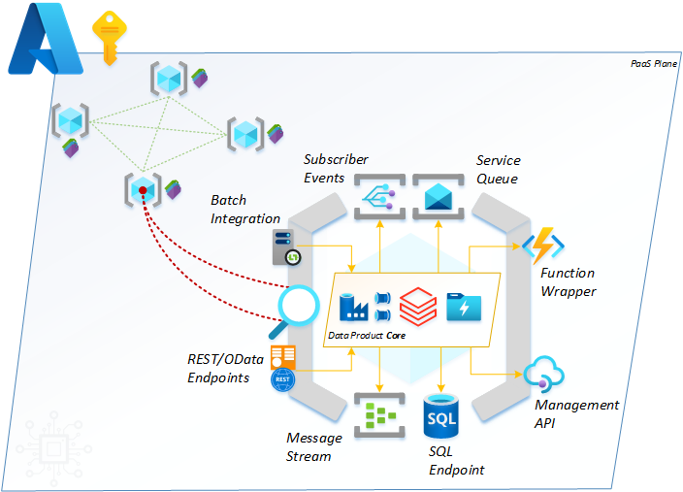
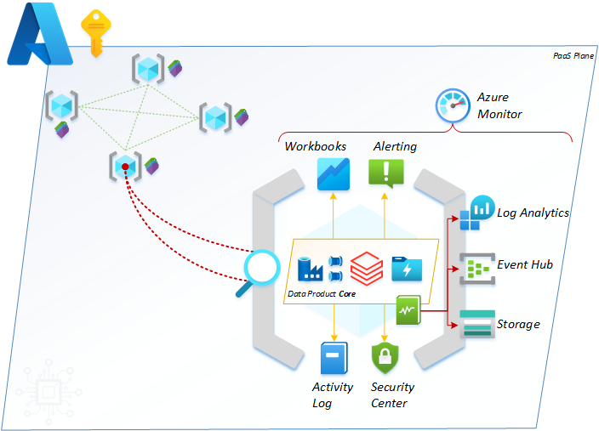
Data Mesh vs Azure – Part 3
Theory vs Practice
Secondary Interfaces - operational reporting and logging.
Primary Interfaces – data integration and exchange.
Tertiary Interfaces - resource connectivity.

Slide 5

Data Mesh vs Azure – Part 4
Theory vs Practice
Blog contributions and wisdom from
Mr Rob Sewell (@sqldbawithbeard).

